Slide 1
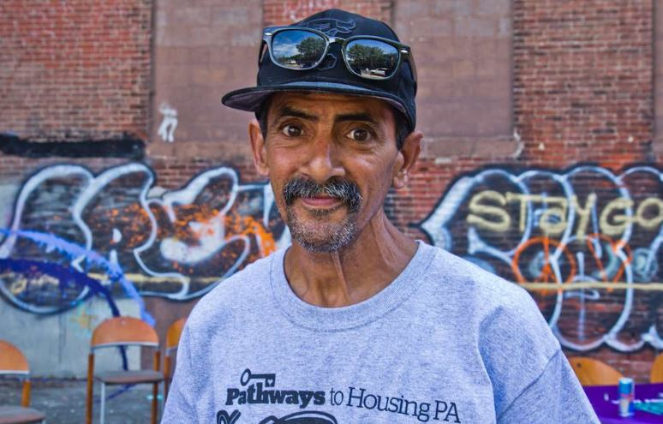
Harm Reduction in Housing First

Slide 2
Matt Tice Oksana Kaczmarczyk
MSW, LCSW
University of Buffalo
Matt Tice has worked his way through the ranks of Pathways to Housing PA, first as an Assistant Team Leader in 2012, then as a Team Leader, and then as Clinical Director in 2014.
MSW, LCSW, LCADC
Rutgers University
Over 9 years of clinical experience working with adults diagnosed with severe mental illness (SMI) and/or substance use D/O. Completed a training course in Cognitive Behavioral Therapy (CBT) through the Beck Institute and use CBT as the main treatment modality.

Slide 3
Mission
The mission of Pathways to Housing PA is to transform individual lives by ending homelessness and supporting recovery for people with severe disabilities.

Slide 4
Person Centered Language
Think of all the labels your participants are given.
Service Providers | People living with addiction
Is there an implicit judgement in how other providers/we label participants? What does the judgement communicate to participants? How does this impact the therapeutic relationship? | How do participants perceive themselves? Are they given the freedom to label themselves? Are they empowered to challenge the labels placed on them?

Slide 5
Language
Junkies, Dope Fiends, Crack-heads, Alcoholic, Crack Babies, Drug Addicts, Drug Abusers, Drug Users, People Who Use Drugs
Drug Use, Drug Abuse, Drug Misuse, Clean and Dirty, Relapse vs. Lapse
A person living with _________ addiction/dependence.
Person in Recovery

Slide 6
Thoughts
Feelings
Actions

Slide 7
Housing First Premise
Immediate access to housing
No requirement for abstinence
No requirement to engage with mental health treatment
Participant driven
Acknowledges that participants can heal and recover in housing rather than on the street

Slide 8
Philosophy and Core Values
Everyone deserves a safe, permanent place to live
Housing is a basic human right
Not a privilege
We believe in the inherent worth and dignity of all people
Safety & Stability – After Housing
Housing Readiness?
Mental Health Recovery Model

Slide 9
Mental Health Recovery Model
SAMHSA - recovery is a process of change through which individuals improve their health and wellness, live self-directed lives, and strive to reach their full potential.
Four main dimensions:
Health—overcoming or managing one’s disease(s) or symptoms
Home—having a stable and safe place to live
Purpose—conducting meaningful daily activities, such as a job, school volunteerism, family caretaking, or creative endeavors, and the independence, income, and resources to participate in society
Community—having relationships and social networks that provide support, friendship, love, and hope

Slide 10
Shame
Shame is built into our culture. Our participants receive it in homeless shelters, on the streets, with their former providers, their families and plenty of other venues.

Slide 11
What is harm reduction?
A pragmatic and compassionate philosophy that accepts the reality that people may engage in high risk behaviors
A set of practical strategies and ideas aimed at reducing negative consequences associated with those risks
A movement for social justice built on a belief in, and respect for, the rights of people who use substances or engage in higher risk activities
Notes:
First definition of harm reduction from HAMS the second is the definition from the Harm Reduction Coalition
A few basic principles…
Drug use exists along a continuum
Abstinence is one of many possible goals
Meet people “where they are at”
Drug-related harm can not be assumed
Drugs can meet important needs
Drug users are more than their drug use

Slide 12
Inclusive Spectrum
Safer Techniques, Managed Use & Total Abstinence

Slide 13
Continuum of Use
No Use
Social & Ritual Use
Experiment
Binge Use
Situational Use
Abuse Habit Chronic
Severe Persistent Chemically Dependent

Slide 14
Health Care Harm Reduction Guiding Principles
Humanism
Pragmatism
Individualism
Autonomy
Incrementalism
Accountability Without Termination

Slide 15
Principles of Harm Reduction
Engagement in treatment is the primary goal
Goals and strategies emerge from the therapeutic process
(Tatarsky A, Marlatt GA, State of the art in harm reduction psychotherapy: An emerging treatment for substance misuse. J Clin Psychol 2010;66:117-122)

Slide 16
Harm Reduction is Not…
Does not mean “anything goes”
Does not condone, endorse, or encourage drug use or high risk behaviors
Does not exclude or dismiss abstinence-based treatment models as viable options
Does not attempt to minimize or ignore the harms associated with licit and illicit drug use, sexual activity or other risks

Slide 17
Common criticisms of harm reduction:
Significant literature supports the opposite (Tsemberis, S., et al. 2004)
Ignores the pragmatic
Abstinence is not the primary goal, reduction of harms while recognizing behaviors that persist is. (Christie T. et al. 2008)
It encourages use
It sends mixed messages about enabling
It fails to get people off substances

Slide 18
Rational Detachment
It’s not about you
Removing your own personal investment

Slide 19
Harm Reduction Coalition Key Principles
Health and Dignity
Participant-Centered
Participant Involvement
Participant Self-Rule
Recognize Inequalities and Injustices
Practical and Realistic

Slide 20
Health and Dignity
Fostering the least amount of harm while also ALWAYS maintaining RESPECT
Housing Context

Slide 21
Participant-Centered
Providers offer services without judging the participant
Programming is low-threshold and accessible
Housing Context

Slide 22
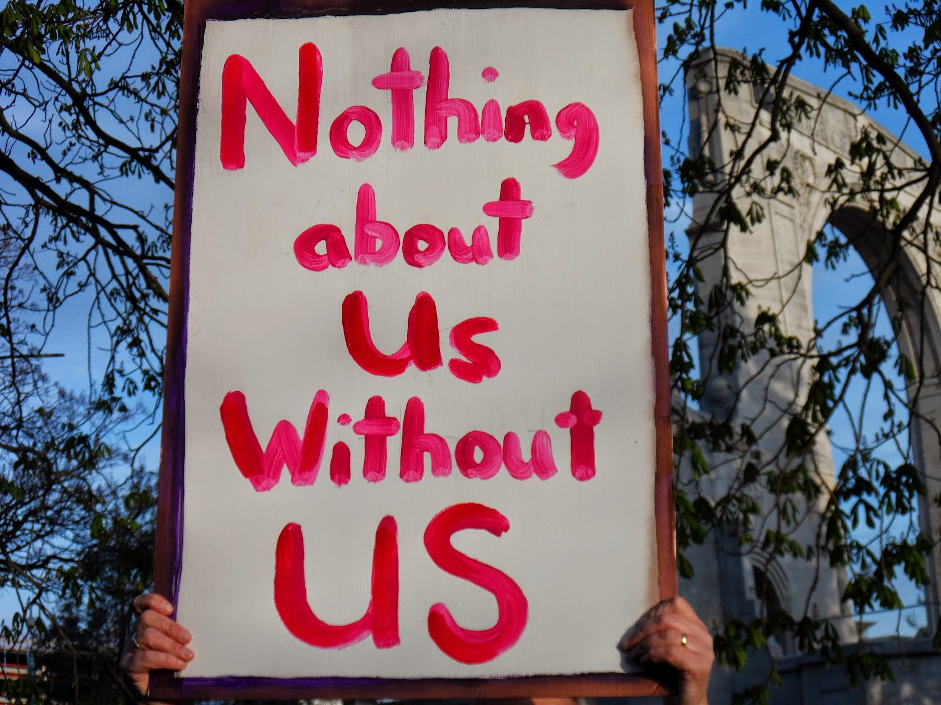
Participant Involvement
Providers ensure the people you are serving have a real voice in the creation of programs and policies designed to serve them.
Not just in the goals developed with them…
Housing Context

Slide 23
Participant Self-Rule
Providers recognize participants are experts in their own lives.
It is the participant who makes their own changes, when they feel they can make them, under their own circumstances.
Housing Context

Slide 24
Recognize Inequalities and Injustices
Providers recognize complexities of:
poverty,
class,
racism,
isolation,
past trauma,
sex-based discrimination and other inequalities
Impact people's vulnerability, and capacity for effectively dealing with behavior-related harm.
Housing Context:

Slide 25
Practical and Realistic
Providers offer practical tools and education to address the real harms and dangers experienced by individuals with significant risk.
Housing Context:

Slide 26
On-Demand Harm Reduction Supports
On-demand –Educate yourself on the needs of those you serve
Always offering additional supports but respecting when individuals decline
How to access things like detox, treatment, or lower intensity interventions
Range of evidence based harm reduction programs that reduce the harms of substance use and promote health that are available, accessible and acceptable to those who need them.
Pauly, B. B., et al. (2013).
Judgement free education on risks of particular substance

Slide 27
Practical examples HR in Housing First
Nicotine Replacement
Education of safer usage practices
Refocusing sexual energies during hypersexualized behavior
Developing ideal use plans
Low profile coaching for housing retention
Reduction of hoarding behaviors
Switching from higher risk substance to lower
Medically Assisted Treatment
Safer Sex & STI Prevention
Method of delivery –
Smoking VS Injection, etc
Syringe Exchange
Repeated overdose education and safety planning
“Don’t Use Alone”
Money management for substance use budgeting

Slide 28
Outcomes of Harm Reduction
Increase trust with clients & foster engagement
Challenge Stigma
Improve public health with individuals and community

Slide 29
Accountability without Termination
Participants are still responsible for the natural consequences of their actions
Did they show up to work high?
Are they posing a threat or continual disturbance their neighbors?
Have they violated their probation?
Are they neglecting bills or rent?
Response to Enabling Question

Slide 30
Safety Planning with a Person Expressing Risk Factors
The Safety Plan is for the participant. Having their own original is 1st priority:
Best if done prior to crisis
Intake is a great time and can be reviewed at crisis or change points
Should be completed for all participants
Components
Warning signs
Internal resources
Natural social supports/distraction
How to make the environment safe
Professional supports
Overdose Risk Assessment
Sequential steps in event of escalation

Slide 31
PTHPA Safety Plan
What are the signs that I might be in a “bad” or dangerous place for myself or others?
Things I can do myself to take my mind off my problems
People who can help distract me if I’m feeling unsafe
Places I can go to take my mind off things
Things I can do to make the area around me safe
Professionals or agencies I can contact during a crisis (list local resources, hotlines, etc.)
Substance Use (if applicable)
Other (Could be a place for sequencing what to do with this info)

Slide 32
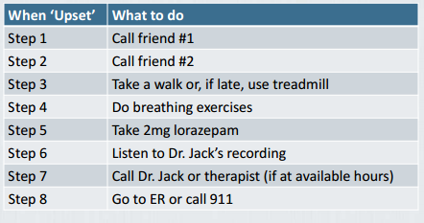
Safety Planning
The “Other” section could be used for sequencing escalation:
Take a walk
Listen to Dr. Dichter’s Recording
Call On-Call
Go to the Crisis Center, ER or call 911

Slide 33
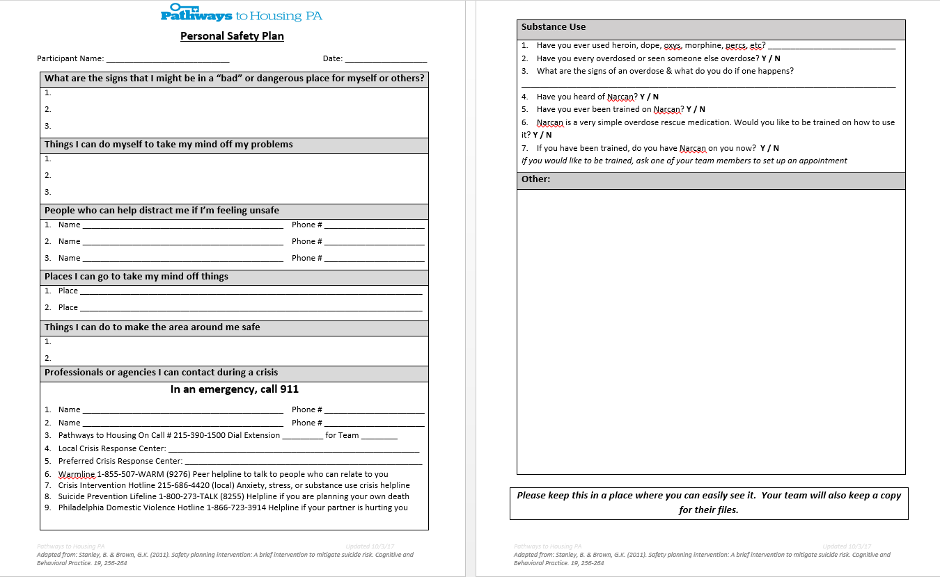

Slide 34
Challenging Stigmatization
Individual Level
Community Level
Staff Level

Slide 35
Individual Level
Language
Honesty
Relationships
Disclosure & Dialogue
Education and personal development

Slide 36
Staff & Community Level
Staff
Training and education
Hiring peers, users, those in recovery
Community
Participant advisory board
Awareness campaigns
Outlets for feedback
Assessment of practices
Policy and advocacy
Events

Slide 37
Case Study
Reggie is a formerly homeless individual working with your agency around housing and behavioral health support. He has a long history of alcohol use and is diagnosed with hepatitis C and cirrhosis. He drinks vodka at the beginning of the month and switches to mouthwash he shoplifts at the end of the month when he runs out of money. He worked with you to get into detox and treatment twice in the last year but is currently drinking again.
He notes a slight interest in moving out of the area where there is a lot triggers though he has grown up in the neighborhood and does not have supports anywhere but here. Neighbors report to the property manager Reggie is friendly when sober but they are about done with his “crazy” when he is not. They know he has someone working with him (you) and try to engage during visits. His landlord regularly complains about his behaviors in his apartment building related to his intoxication.
Health and Dignity
Participant-Centered
Participant Involvement
Participant Self-Rule
Recognize Inequalities and Injustices
Practical and Realistic

Slide 38
Case Study
Reggie is a formerly homeless individual working with your agency around housing and behavioral health support. He has a long history of alcohol use and is diagnosed with hepatitis C and cirrhosis. He drinks vodka at the beginning of the month and switches to mouthwash he shoplifts at the end of the month when he runs out of money. He worked with you to get into detox and treatment twice in the last year but is currently drinking again.
He notes a slight interest in moving out of the area where there is a lot triggers though he has grown up in the neighborhood and does not have supports anywhere but here. Neighbors report to the property manager Reggie is friendly when sober but they are about done with his “crazy” when he is not. They know he has someone working with him (you) and try to engage during visits. His landlord regularly complains about his behaviors in his apartment building related to his intoxication.
Practical Applications
Health Needs- Hep C & Cirrhosis
Substance Management – Vodka vs mouthwash
Money Management – budgeting for alcohol so he doesn’t switch to a higher risk substance - mouthwash
Client-Direction – Ambivalence in treatment, moving
On demand access to treatment and harm reduction support
Advocacy Needs? Is he being scapegoated because of his enrollment in a “program?”

Slide 39
Case Study
Michaela had been engaged for years before she came in to housing 3 months ago. She more or less sees her apartment as a storage unit to drop off her ever increasing collection of things like books & other items, chain smoke smoke cigarettes, and sleep at night. Her landlord complains to you regularly about the accumulation of items he believes is there and smells coming from her apartment.
Michaela has said she likes being in away from the cold and doesn’t like the threat of being hassled by cops or having her stuff stolen while on the street. She has limited mobility issues due to the need for a hip replacement. She has not wanted to engage in medical care but complains about pain. She has self medicated with illicit substances for the pain in the past which she denies now. The accumulation of items in her apartment has posed a fall and collapse risk to her.
Health and Dignity
Participant-Centered
Participant Involvement
Participant Self-Rule
Recognize Inequalities and Injustices
Practical and Realistic

Slide 40
Case Study
Michaela had been engaged for years before she came in to housing 3 months ago. She more or less sees her apartment as a storage unit to drop off her ever increasing collection of things like books & other items, chain smoke smoke cigarettes, and sleep at night. Her landlord complains to you regularly about the accumulation of items he believes is there and smells coming from her apartment.
Michaela has said she likes being in away from the cold and doesn’t like the threat of being hassled by cops or having her stuff stolen while on the street. She has limited mobility issues due to the need for a hip replacement. She has not wanted to engage in medical care but complains about pain. She has self medicated with illicit substances for the pain in the past which she denies now. The accumulation of items in her apartment has posed a fall and collapse risk to her.
Practical Applications
Health Needs- Chronic Pain, Need for Hip Replacement, Fire risk with smoking in apartment and accumulation of items
Substance Management – Nicotine Replacement? Pain Management
Client-Direction – Ambivalence about reduction of behaviors
Hoarding Support
Advocacy Needs? Is she being scapegoated because of her enrollment in a “program?”

Slide 41
Case Study
Elana only just recently moved into an apartment through your program after 3 years on the street. She has a long history of misusing Xanax and opioids. She is currently using heroin. She previously was engaged with a methadone maintenance program but she was discharged due to non-adherence. She said she hated being in the groups because it aggravated her anxiety. She would like to re-engage with some sort of Medically Assisted Therapy.
Elana was hospitalized last week for a severe abscess on her foot. She received a skin graft to in order to save her foot. She has had a very difficult time in the hospital because she feels they are not medicating her pain. She called you to tell you she was considering leaving the hospital AMA.
Health and Dignity
Participant-Centered
Participant Involvement
Participant Self-Rule
Recognize Inequalities and Injustices
Practical and Realistic

Slide 42
Case Study
Elana only just recently moved into an apartment through your program after 3 years on the street. She has a long history of misusing Xanax and opioids. She is currently using heroin. She previously was engaged with a methadone maintenance program but she was discharged due to non-adherence. She said she hated being in the groups because it aggravated her anxiety. She would like to re-engage with some sort of Medically Assisted Therapy upon discharge from the hospital.
Elana was hospitalized last week for a severe abscess on her foot. She received a skin graft to in order to save her foot. She has had a very difficult time in the hospital because she feels they are not medicating her pain. She called you to tell you she was considering leaving the hospital AMA.
Practical Applications
Immediate stabilization and affirmation of support
Health Needs- Abscess, Major Overdose Risk,
Substance Management – Harm reduction based supports until MAT, Readiness for change? Naloxone
Client-Direction – What are her goals? MAT
Advocacy Needs- Is she being medicated appropriately? Impact of labels?

Slide 43
Recap
Main Tenant of Housing First
Person-Centered
Start where they are
Safety Focus to
Be educated on practical examples based on participant’s needs
Challenge stigmatization

Slide 44
Thank you

Slide 45
Discussion

Slide 46
Contact PTHPA @
Web address: www.pathwaystohousingpa.org
Main number: 215-390-1500
Email address: training@pathwaystohousingpa.org

Slide 47
Bibliography
Tatarsky A, Marlatt GA, State of the art in harm reduction psychotherapy: An emerging treatment for substance misuse. J Clin Psychol 2010;66:117-122
Mental Health Recovery Model SAHMSA - Retrieved from https://www.samhsa.gov/recovery
Harm Reduction Coalition - Retrieved from http://harmreduction.org/
Tsemberis, S., Gulcur, L., & Nakae, M. (2004). Housing first, consumer choice, and harm reduction for homeless individuals with a dual diagnosis. American Journal of Public Health, 94(4), 651-656.
Hawk, M., Coulter, R. W., Egan, J. E., Fisk, S., Friedman, M. R., Tula, M., & Kinsky, S. (2017). Harm reduction principles for healthcare settings. Harm reduction journal, 14(1), 70.
Christie, T., Groarke, L., & Sweet, W. (2008). Virtue ethics as an alternative to deontological and consequential reasoning in the harm reduction debate. International Journal of Drug Policy, 19(1), 52-58.
Pauly, B. B., Reist, D., Belle-Isle, L., & Schactman, C. (2013). Housing and harm reduction: What is the role of harm reduction in addressing homelessness?. International Journal of Drug Policy, 24(4), 284-290.
Stanley, B. & Brown, G.K. (2011). Safety planning intervention: A brief intervention to mitigate suicide risk. Cognitive and Behavioral Practice. 19, 256-264

